Slide 1
Temporal phosphorylation and network analysis of yeast signaling
Speaker: Dylan Cronin
Home Institution: Bowling Green State University
Mentors: Dr. Anthony Gitter and Nafisah Islam
Date: August 3, 2016
Department of Biostatistics and Medical Informatics at the University of Wisconsin-Madison

Slide 2
Is the Temporal Pathway Synthesizer effective in using temporal phosphoproteomic data to determine the osmotic stress response protein signaling pathway in yeast?
Notes:
The temporal pathway synthesizer is an algorithm that looks at the timing of the phosphorylation of proteins.
Phosphoproteomic data is the phosphorylation data of the proteins obtained through mass spectrometry.
The osmotic stress response is a salt stress on the cell.

Slide 3
How do proteins interact with one another?
ATP
ADP
P
Kinase
OFF
ON
Notes:
Protein interactions most often occur through phosphorylation.
A Phosphate group is added onto the protein via a kinase
This phosphate group often can make this protein change shape.
Conformational change can allow for the interaction with other proteins, and then cause a cascade of interactions.

Slide 4
What are protein-protein interaction networks?
Notes:
Protein-Protein interactions are often represented by some sort of graph. Where each of the circles here represents some sort of protein, and the lines in between them, called edges, represent an interaction between the two proteins. Interactions can be anything from phosphorylation to ubiquitination, but more often than not, the interaction between two proteins is phosphorylation.
First, there is some kind of stimulus to the cell, which binds to these receptor proteins.
The receptor proteins then most likely interact with proteins within the cell.
Proteins interact together to produce some specific result

Slide 5
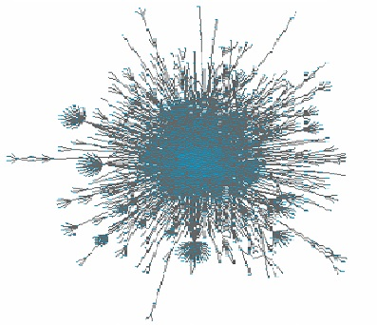
Why analyze protein interaction networks?
Allows one to identify what proteins are involved for particular cellular responses.
Network analysis has the potential to create a method to prevent a particular cellular response by inhibiting specific proteins.

Slide 6
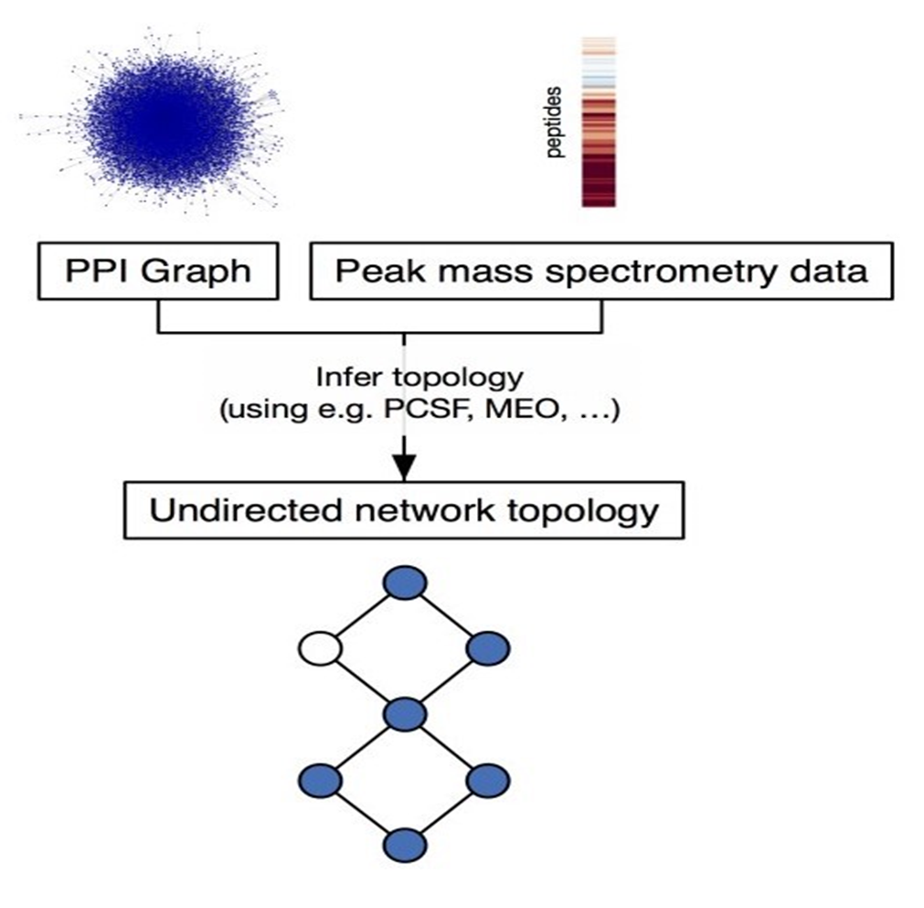
Methods
.20
.76
.90
.87
.10
.04
.18
.39
.84
.73
.31
.71
Notes:
First we start with a graph with thousands of interactions, that is largely meaningless.
Then, we have mass spectrometry data for each protein that allows for the inference of various possible networks.
We use this phosphorylation data to prune a network possibility as given on the right to maximize the prizes of the nodes and minimize edge costs, which is related to reliability.
Finally, we obtain some undirected coarse network

Slide 7
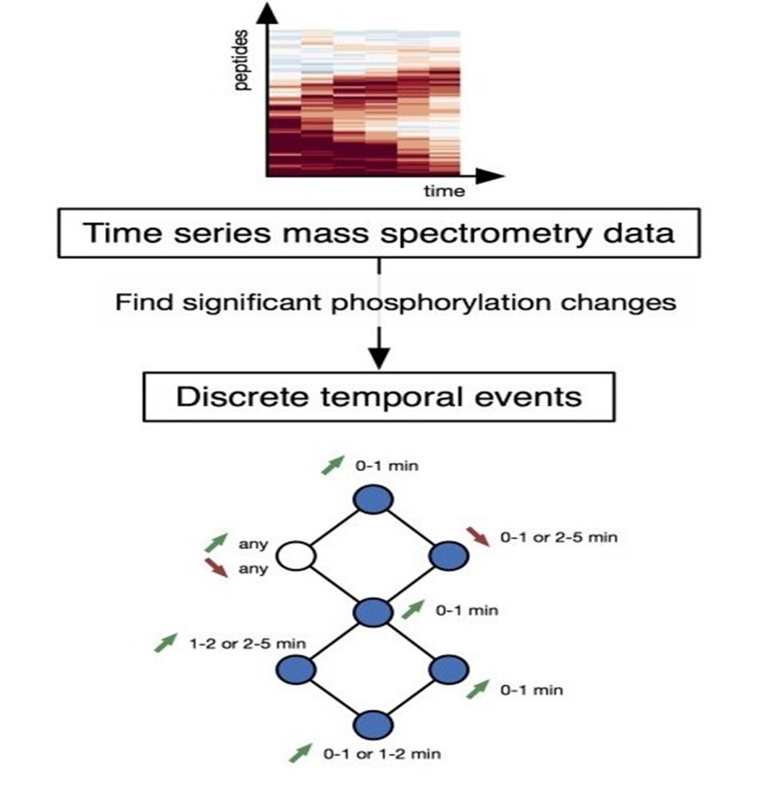
Methods
Use time series phosphorylation data to further refine the original coarse network created from the Forest module.
Assess the quality of the predicted signaling pathway using pathway databases and related literature.
Notes:
X and Y axis!

Slide 8

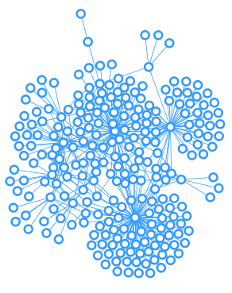
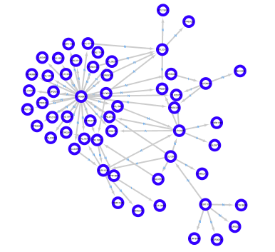
Results
PCSF
TPS
3543 Nodes
7616 Edges
250 Nodes
344 Edges
55 Nodes
72 Edges
Notes:
We started with a large network of 3 thousand plus proteins, and pruned the network down sequentially until we obtained something useful.
Then we checked whether these pathways appear in databases already known, and some of these nodes do.

Slide 9
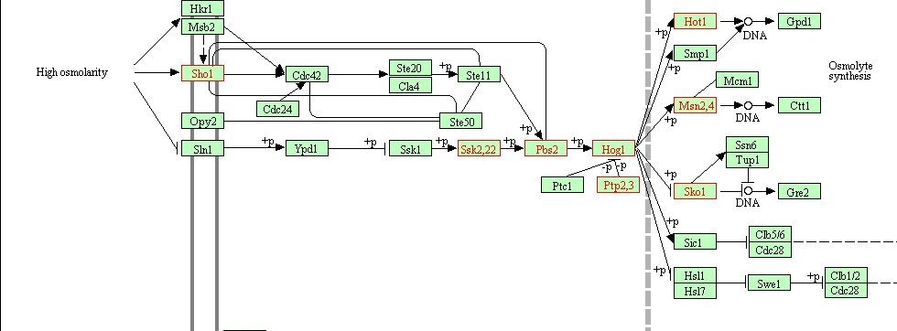
Results
Notes:
The red highlighted nodes above show the

Slide 10
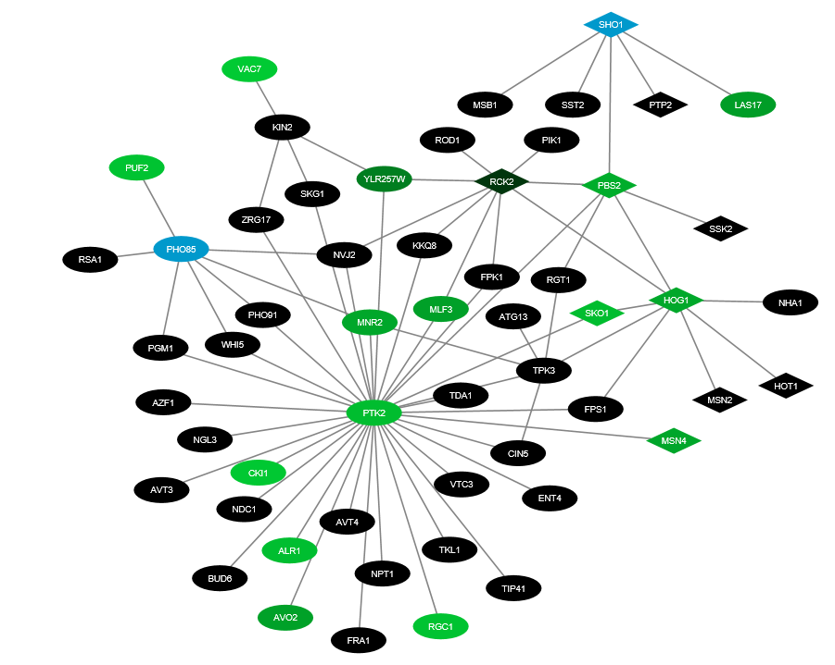
Final Network
Found In Literature for Osmotic Stress Response
Gradient of Increasing Phosphorylation Intensity
Non-Phosphorylated Protein

Slide 11
Summary
Proteins interact with one another through phosphorylation.
A cascade of protein interactions results from a particular stimulus to the cell.
The methods used resulted in a network consistent, in many respects, with the signaling pathways found in literature, and produced new interactions that need to be investigated further.

Slide 12



Acknowledgments
Dr. Anthony Gitter
Nafisah Islam
Dr. Amber Smith
Whitney Sweeney
Department of Biostatistics and Medical Informatics
Center for Predictive Computational Phenotyping

Slide 13
References
1. Chasman, Deborah et al. “Pathway connectivity and signaling coordination in the yeast stress-activated signaling network.” Mol Syst Biol. (2014) 10: 759.
2. Koskal, Ali Sinan et al. “Synthesizing Signaling Pathways from Temporal Phosphoproteomic Data.” Unpublished.
3. Tuncbag, Nurcan, et al. "Network-Based Interpretation of Diverse High-Throughput Datasets through the Omics Integrator Software Package." PLoS Comput Biol 12.4 (2016): e1004879.

Slide 14
Questions?

